Slide 1
PATIENT HEALTH RISK
ASSESSMENT SYSTEM
Machine Learning Based Health-Risk Prediction
Project Team
2520030233-K. Akshitha
2520030245-T. Meghana
2520030235-Sreekara Karthik
Machine Learning | Academic Project

Slide 2
1. Project Overview
What the system does
Objective
Problem
Use patient medical and lifestyle parameters to classify a patient into a possible Low, Medium, or High health-risk category.
Manual analysis of many patient parameters can be time-consuming. Machine Learning can learn patterns from historical data and support risk assessment.
Approach
Data → Cleaning → Encoding → EDA → Train/Test Split → ML Models → Evaluation → New Patient Prediction
• Academic decision-support prototype
• Not a replacement for professional medical diagnosis
Patient Health Risk Assessment System | Machine Learning
2

Slide 3
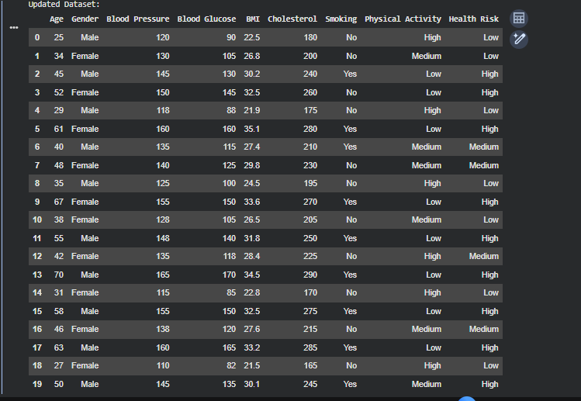
2. Dataset & Features
Patient attributes used for prediction
Dataset
20 records before cleaning
9 attributes
8 Input Features
Age, Gender, Blood Pressure, Blood Glucose, BMI, Cholesterol, Smoking, Physical Activity
Target
Health Risk → Low / Medium / High
Patient dataset screenshot
Patient Health Risk Assessment System | Machine Learning
3

Slide 4
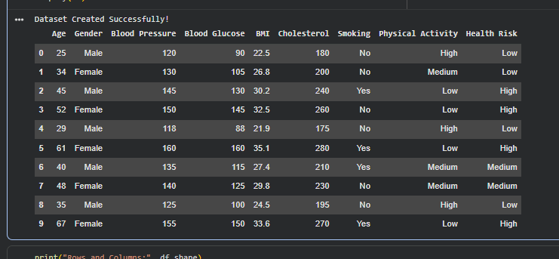
3. Data Cleaning & Preprocessing
Preparing reliable data for Machine Learning
Before Cleaning
Cleaning
After Cleaning
20 records
5 missing values
4 duplicate records
Remove duplicate rows
Numerical missing values → median
Categorical missing values → mode
16 unique records
0 missing values
0 duplicate rows
• LabelEncoder converts categorical text into numerical values.
• Example: Gender, Smoking, Physical Activity and Health Risk are encoded before model training.
Cleaned dataset
Patient Health Risk Assessment System | Machine Learning
4

Slide 5
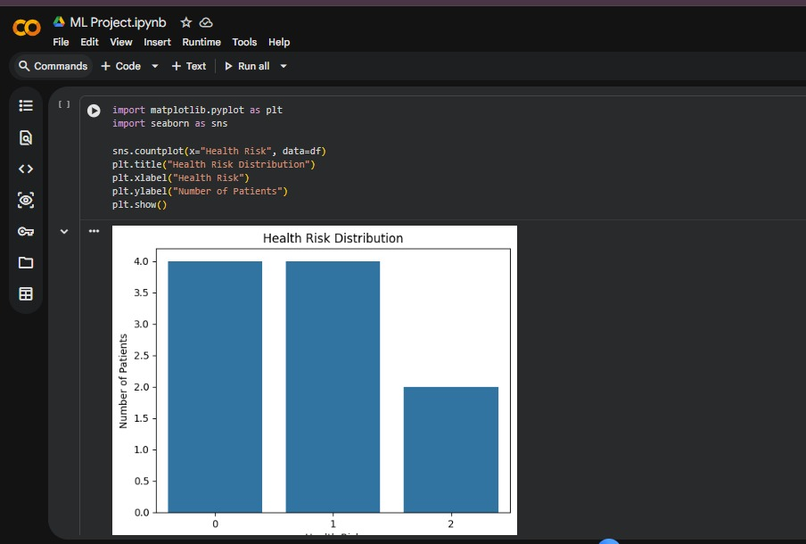
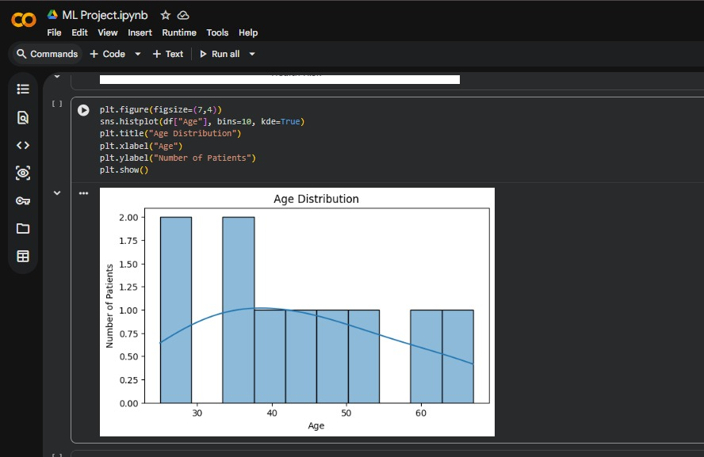
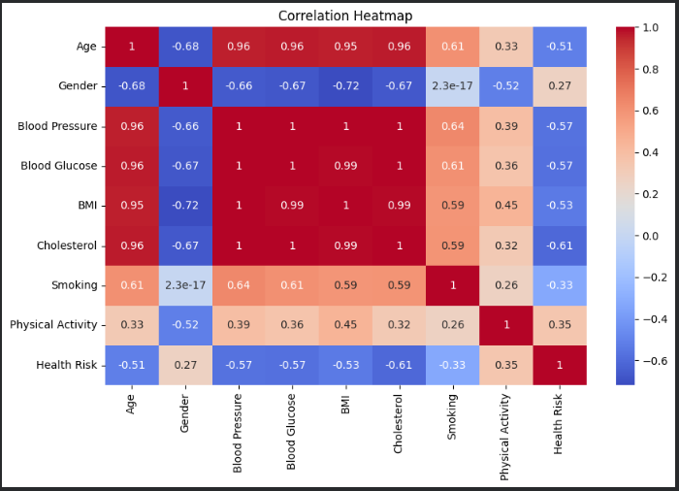
4. Exploratory Data Analysis
Visualizing patterns and relationships in the data
Health Risk Distribution
Age Distribution
Correlation Heatmap
• Distribution plots show how patient ages and risk categories are spread.
• Boxplots compare BMI and Blood Pressure across health-risk categories.
• The correlation heatmap summarizes relationships between numerical variables.
Patient Health Risk Assessment System | Machine Learning
5

Slide 6
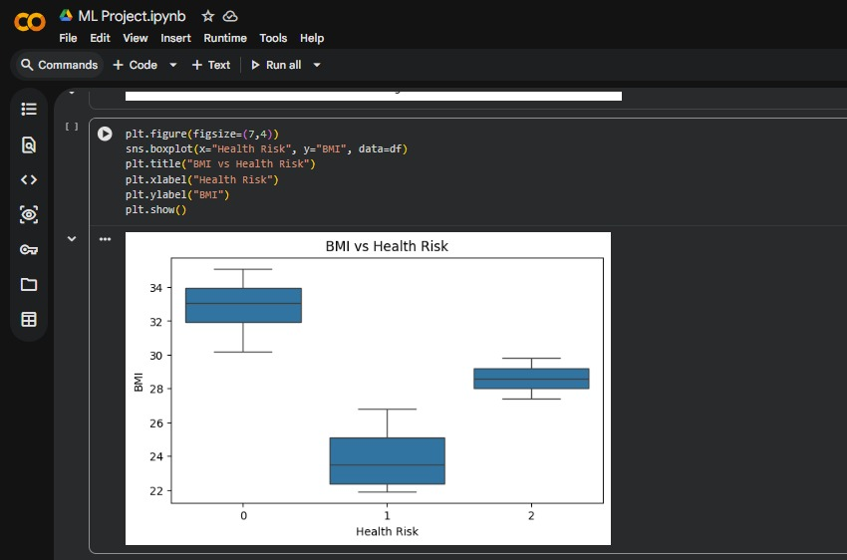
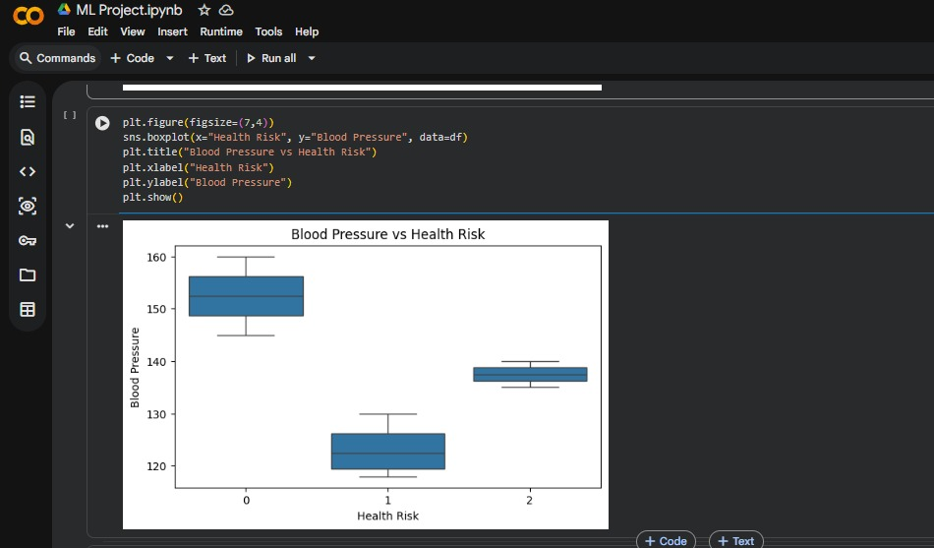
5. BMI & Blood Pressure Analysis
Comparing important health parameters with risk categories
BMI vs Health Risk
Blood Pressure vs Health Risk
Patient Health Risk Assessment System | Machine Learning
6

Slide 7
6. Machine Learning Models
Three classification algorithms are compared
Logistic Regression
Decision Tree
Random Forest
Classification model that learns a mathematical relationship between features and risk classes.
Uses a sequence of decision rules to reach a final health-risk class.
Combines multiple Decision Trees. In our implementation, 100 trees are used.
• Why three models? To compare different classification approaches on the same patient dataset.
• Training data is used to learn patterns; testing data is used to evaluate unseen examples.
Patient Health Risk Assessment System | Machine Learning
7

Slide 8
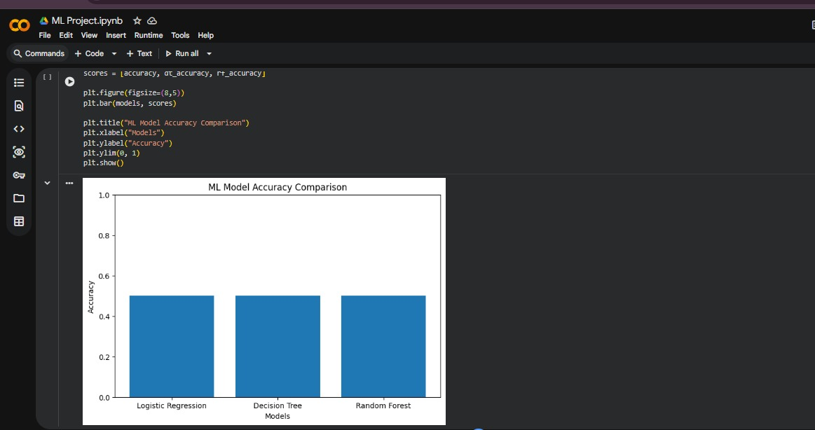
7. Model Evaluation
Measuring prediction performance
Evaluation Metrics
Accuracy • Precision • Recall • F1-score • Confusion Matrix
Current Result
On the current small test split, all three models achieved 50% accuracy. This is a project demonstration result and is not sufficient for real-world clinical use.
Model comparison
Patient Health Risk Assessment System | Machine Learning
8

Slide 9
8. New Patient Prediction
Using the trained model for a new patient
Input
Prediction
Age, Gender, Blood Pressure, Blood Glucose, BMI, Cholesterol, Smoking, Physical Activity
The trained classifier processes the new patient features and returns a predicted risk category: Low, Medium, or High.
Patient Data
Encoding
Trained Model
Risk Category
Model Saving
The Random Forest model is saved using Joblib so it can be reused later.
Patient Health Risk Assessment System | Machine Learning
9

Slide 10
9. Conclusion & Future Scope
Summary of the project
Conclusion
Future Scope
The project demonstrates the complete Machine Learning workflow: data cleaning, preprocessing, visualization, classification, evaluation and health-risk prediction.
Use a much larger and more diverse dataset, improve model validation, test additional algorithms, and develop a user-friendly application.
• The system is an academic decision-support prototype.
• Predictions should not be treated as medical diagnosis.
• Larger real-world datasets are needed for reliable generalization.
Thank You
Patient Health Risk Assessment System | Machine Learning
10

